Slide 1
Marketplace App
Haaris Naseeb
Janis Grikstas
Julius Mitchell
Shaike Rushapi

Slide 2
Demo
MarketPlace

Slide 3
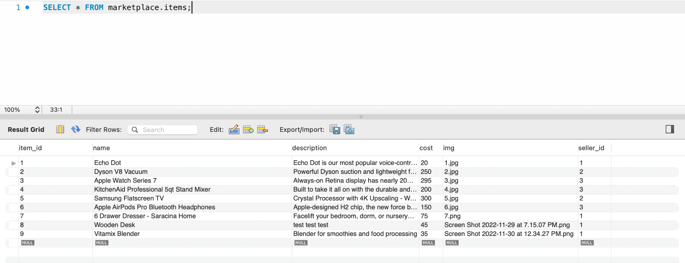
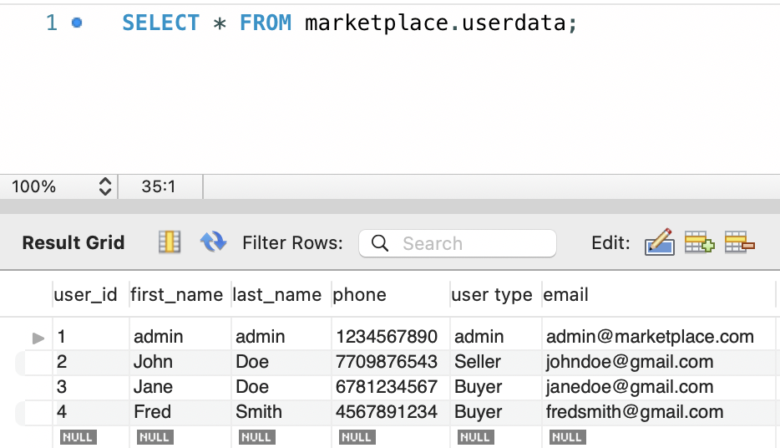
Backend Setup

Slide 4
Purpose of the Software
A marketplace app is a software that enables purchasing and selling over the internet in a convenient way.
It enables the seller to add products for sell, make changes, manage inventory, process payments and fulfill orders through this online app.
The buyer gets to search products,check prices, add items to carts, and buy them at checkout all in one single app.
Offers faster buying and selling process and flexibility to both buyer and seller; reduces cost, saves time, provide decent customer service.

Slide 5
Functional Requirements
Web friendly app
Product Information Management
Different portals/views for different types of users
Order Management
Payment Security
Notes:
Web-friendly application - online shopping is the new normal when it comes to buying and selling items. It’s a marketplace website so that it can be accessed by all.
2. This software is managing the entire product data repository and designing product pages. attributes to products (price, description, item id) can be assigned.
3. Seller portal lets registered sellers to list items for sale, and view their current listing, while the buyer portal let’s shoppers browse all products
4. A well-designed frontend and a robust backend are key ingredients for a successful business. All the orders and products will be saved in the database which will integrate with the app to provide a great experience on both seller and buyer end.
5. It offers flexible payment option for the buyer and performs card authentication for a smooth and reliable transaction.

Slide 6
Non-Functional Requirements
Usability Requirements
Security Requirements
Performance Requirements
Maintainability Requirements
Scalability Requirements
Notes:
-Usability for this app narrows down to: how fast a user can meet their desired result on a single page click, how fast a user can perform tasks, how natural the design is, and the amount of errors a user can make.
-Security is the most important non-functional requirement needed for the Marketplace app.
Performance - application should be able to load as fast as possible and should be able to maintain a good speed during heavy traffic and there should be no performance degradation
Maintainability - application should be able made in a way where it’s easy to make changes, fix bugs, and add new functionality. We also want to minimize downtime as much as possible. Maintenance time should be as minimal as possible
Scalability - As the website grows, it should be able to handle the increasing number of users. Which also means purchasing additional hardware and software resources such as memory and servers. Must also take into account resources needed to expand business globally

Slide 7
Summary of Team Experience
Our main goal for our Marketplace app was to create and understand an interface that involves the transactions of goods between buyers and sellers.
This was a very interesting experience for learning the many ins and outs behind creating a digital marketplace.
We managed to meet much of the initial framework of what we wanted to achieve in creating this app.

Slide 8
Thank You!

